Slide 1
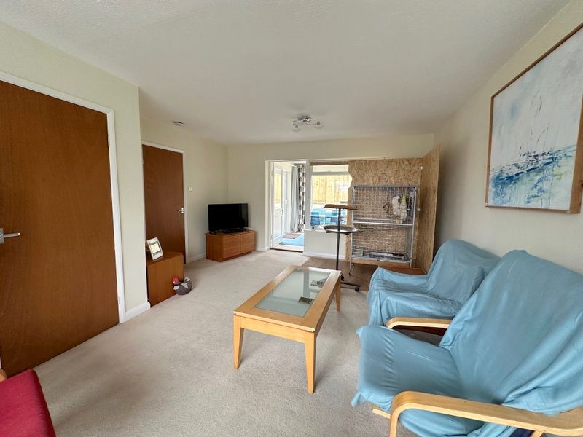
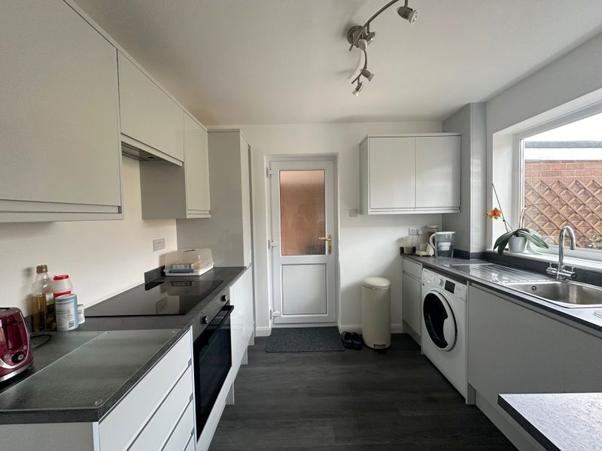
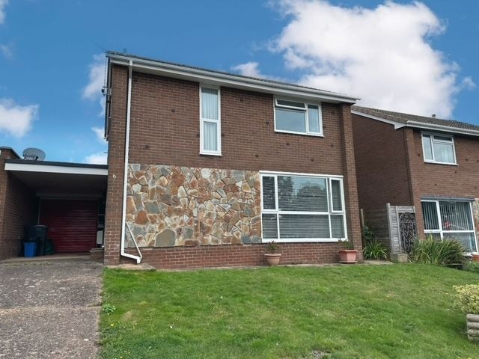
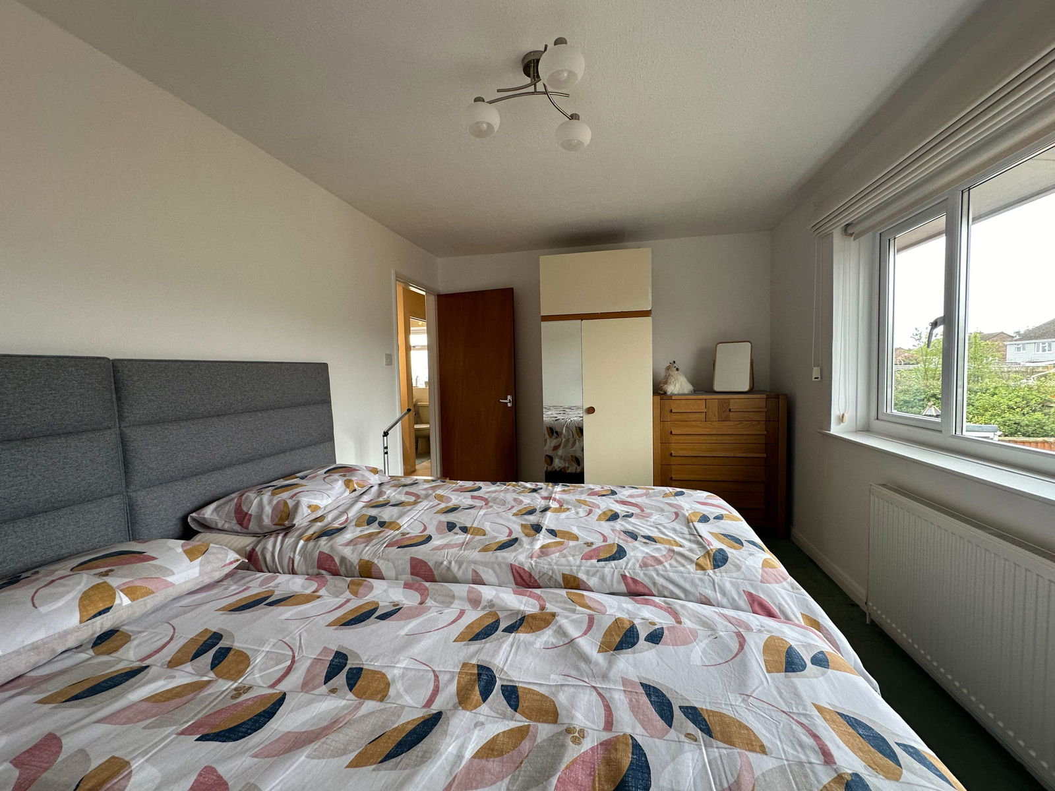
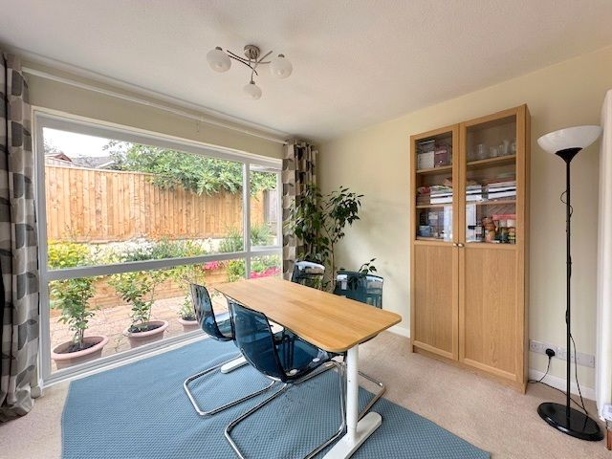
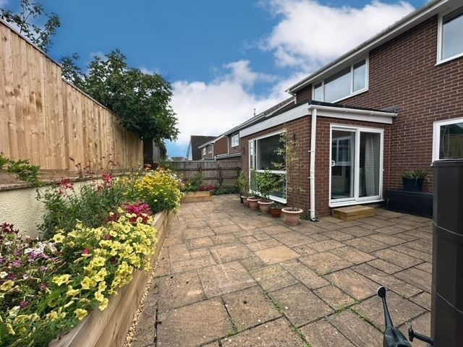
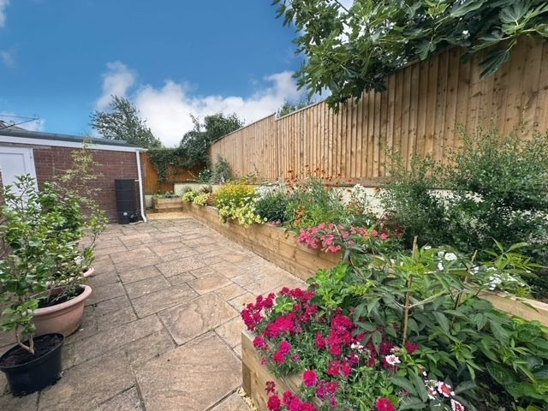
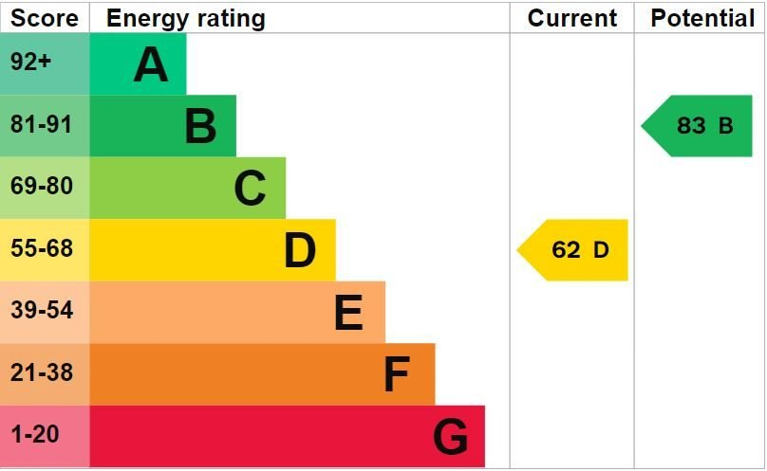
www.pennys.net
6 Walls Close, Exmouth, EX8 4LY
GUIDE PRICE £381,950
TENURE Freehold
A Well Maintained Three Bedroom Detached House Enjoying Bright Living Accommodation And Located In A Quiet Cul-De-Sac Close To A Range Of Amenities With No Onward Chain
Reception Hall • Spacious Lounge/Dining Room
Newly Fitted Modern Kitchen • Ground Floor Cloakroom/WC
Sun Room Extension • Three First Floor Bedrooms • Bathroom/WC • Newly Fitted Boiler Attractive Rear Garden, Carport And Garage • Recently Redecorated
Pennys Estate Agents Limited for themselves and for the vendor of this property whose agents they are give notice that:- (1) These particulars do not constitute any part of an offer or a contract. (2) All statements contained in these particulars are made without responsibility on the part of Pennys Estate Agents Limited. (3) None of the statements contained in these particulars are to be relied upon as a statement or representation of fact. (4) Any intending purchaser must satisfy himself/herself by inspection or otherwise as to the correctness of each of the statements contained in these particulars. (5) The vendor does not make or give and neither do Pennys Estate Agents Limited nor any person in their employment has any authority to make or give any representation or warranty whatever in relation to this property.
PENNYS ESTATE AGENTS
2 Rolle House, Rolle Street, Exmouth, Devon, EX8 2SN
Tel: 01395 264111 EMail: help@pennys.net

Slide 2
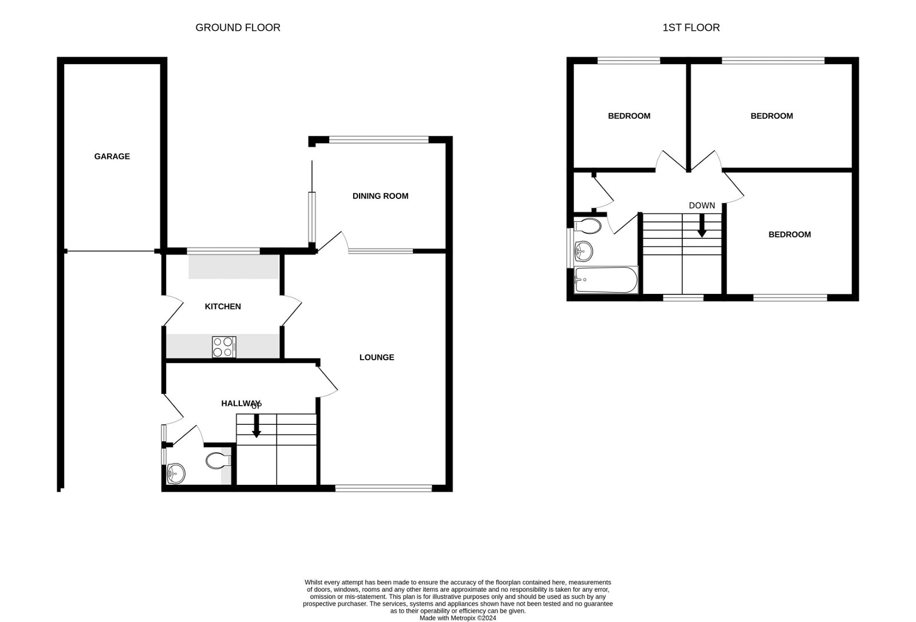
6 Walls Close, Exmouth, EX8 4LY
THE ACCOMMODATION COMPRISES: uPVC front door with double glazed patterned window inset and matching picture window side screen giving access to the: RECEPTION HALL: A fine entrance to the property with turning staircase rising to the first floor; uPVC double glazed window on half-landing; useful understairs storage cupboard; radiator; telephone point. GROUND FLOOR CLOAKROOM/WC: Comprising of a wash hand basin with chrome mixer tap, tiled splash back and cabinet beneath; WC with concealed cistern and push button flush; adjoining cupboard and drawer unit with display surface over; fitted mirror with LED display light; slimline cupboard and shelving unit; shaver socket; uPVC double glazed window with patterned glass. LOUNGE/DINING ROOM: 5.92m x 4.17m (19'5" x 13'8") Narrowing to 10'8" (3.25m). A bright and spacious room with large uPVC double glazed windows to the front aspect; additional window over looking the dining/sun room extension; part glazed door leading to the dining/sun room extension; three radiators. DINING/SUN ROOM EXTENSION: 3.35m x 2.79m (11'0" x 9'2") A superb addition to the accommodation with uPVC double glazed windows overlooking the rear garden; uPVC double glazed patio doors opening onto rear garden; radiator. KITCHEN: 2.92m x 2.84m (9'7" x 9'4") Recently re-fitted with pattern worktop surfaces with matching splashbacks; gloss fronted cupboards and drawer units; freestanding Hotpoint washer/dryer beneath worktop surfaces; integrated slimline dishwasher; inset single drainer sink unit with chrome mixer tap; four ring ceramic hob with electric oven below and concealed extractor hood over; newly bought freestanding fridge freezer; wall mounted cupboards; upright pantry cupboard; uPVC double glazed window overlooking rear garden and uPVC double glazed door with patterned inset giving access to carport. FIRST FLOOR LANDING: With access via loft ladder to roof space; linen cupboard with slatted shelving and housing the gas fired boiler serving domestic hot water and gas central heating; doors leading to: BEDROOM ONE: 4.11m x 2.87m (13'6" x 9'5") uPVC double glazed window to rear aspect; radiator. BEDROOM TWO: 3.23m x 2.95m (10'7" x 9'8") uPVC double glazed window to front aspect; radiator. BEDROOM THREE: 2.9m x 2.77m (9'6" x 9'1") uPVC double glazed window to rear aspect; free-standing wardrobe with double sliding doors (one mirror fronted) with clothes rail and shelving; radiator. BATHROOM/WC: Comprising of a bath with hand grips and shower unit over; pedestal wash hand basin; WC; chrome heated towel rail with individual thermostat control; fully tiled walls; uPVC double glazed window with patterned glass.
OUTSIDE: To the front of the property there is a lawned area of garden with patio sun terrace adjoining the front of the property. A driveway provides off-road parking and leads to a CAR PORT AREA with light connected and housing the electric consumer unit, electric meter and in-turn leads to the garage. The rear garden is fully enclosed and planned with ease of maintenance in mind with a newly installed raised bed stocked with a variety of shrubs and plants. Enjoying a high degree of privacy and seclusion it comprises of a patio sun terrace, patio pathway with gate giving access to the front of the property, outside cold water tap. GARAGE: 4.9m x 2.59m (16'1" x 8'6") With up and over door; power and light connected; uPVC double glazed window to rear aspect; uPVC door giving access into the rear garden.
AGENTS NOTE: Council Tax Band D. Property Size – 91 Square Meters.
FLOOR PLAN:

